Slide 1
Lecture 06
Semantic Analysis

Slide 2
Outline
Semantic Analysis
Attributes and Attribute Grammars
Dependency Graphs and Algorithms for Attribute Computation
Symbol Table and Scope Checking
Type Checking for Semantic Analysis of a Program

Slide 3
II. Algorithms for Attribute Computation
1. Dependency Graphs and Evaluation Order
2. Synthesized and Inherited Attributes
a Synthesized attributes
b Inherited attributes

Slide 4
1 Dependency Graphs and Evaluation Order
Dependency Graph of a grammar rule
Given an attribute grammar, each grammar rule has an associated dependency graph
Each attribute X_{i}.a_{j} of each symbol corresponds to a node
For each attribute equation X_{i}.a_{j}=f_{ij}(…,X_{m}.a_{k},…) , there is an edge from each node X_{m}.a_{k} in the right-hand side to the node X_{i}.a_{j} (expressing the dependency of X_{i}.a_{j} on X_{m}.a_{k})

Slide 5
Example
Attribute grammar for variable declarations
The dependency graph for grammar rule:
varlist1->id,varlist2 {id.dtype=varlist1.dtype varlist2.dtype=varlist1.dtype}
varlist1.dtype
id.dtype
varlist2.dtype
varlist->id {id.dtype=varlist.dtype}
varlist.dtype
id.dtype
decl->type varlist {varlist.dtype=type.dtype}
type.dtype
varlist.dtype

Slide 6
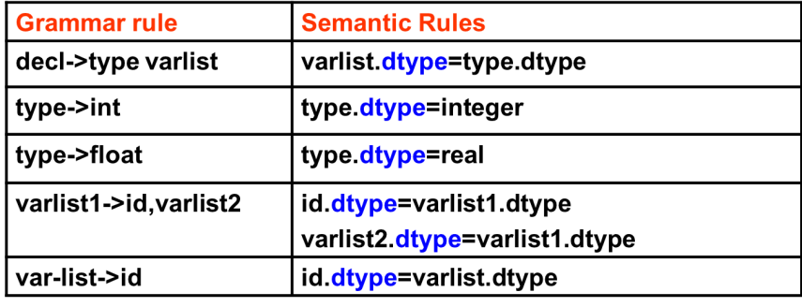
Dependency graph of a legal string
The dependency graph of a legal string generated by the context-free grammar is the union of the dependency graphs of the grammar rule choices representing each node of the parse tree of the string
The dependency graph for string “float x,y”
decl
type
varlist
dtype
dtype
float
id(x)
,
varlist
dtype
dtype
id(y)
dtype

Slide 7
2 Synthesized and Inherited Attributes
Attribute evaluation depends on an explicit or implicit traversal of the parse tree
Different kinds of traversals vary in power in terms of the kinds of attribute dependencies that can be handled
We must classify attributes by the kinds of dependencies they exhibit
Synthesized attribute
Inherited attribute

Slide 8
a Synthesized Attribute
An attribute is synthesized if all its dependencies point from child to parent in the parse tree.
Equivalently, an attribute a is synthesized if, given each grammar rule A->X1X2…Xn, the only associated attribute equation with an a on the left-hand side is of the form
A.a=f(x1.a1,..X1.ak,…,Xn.a1,…Xn.ak)

Slide 9
Example: Synthesized attribute
Attribute grammar for simple integer arithmetic expression
Grammar rule | Semantic Rules
E→E¹+T | E.val ＝E¹.val +T.val
E→T | E.val ＝T.val
T→T¹*F | T.val ＝T¹.val * F.val
T→F | T.val ＝F.val
F→(E) | F.val ＝E.val
F→num | F.val ＝num.val
The val attribute is synthesized

Slide 10
Evaluation of Synthesized Attributes
Given that a parse tree or syntax tree has been constructed by a parser
The synthesized attribute values can be computed by a single bottom-up, or postorder traversal of the tree
Express this by the following code:
procedure PostEval(T:treenode)
begin
for each child C of T do
PostEval(C);
compute all synthesized attributes of T;
end;

Slide 11
S-attributed grammar
An attribute grammar in which all attributes are synthesized is called an S-attributed grammar

Slide 12
b Inherited Attribute
An attribute that is not synthesized is called an inherited attribute
Inherited attributes have dependencies that flow either from parent to children in the parse tree or from sibling to sibling
Two basic kinds of dependency of inherited attributes:
a A
A
a B
a C
B a
a C
(a) Inheritance from parent to siblings
(b) Inheritance from sibling to sibling

Slide 13
Example: Inherited Attribute
Attribute grammar for variable declarations
Grammar rule | Semantic Rules
decl->type varlist | varlist.dtype=type.dtype
type->int | type.dtype=integer
type->float | type.dtype=real
varlist1->id,varlist2 | id.dtype=varlist1.dtype varlist2.dtype =varlist1.dtype
var-list->id | id.dtype=varlist.dtype
The dtype attribute is inherited

Slide 14
Evaluation of Inherited Attributes
Inherited attributes can be computed by a preorder traversal of the parse tree
Express this by the following code
procedure PreEval(T:treenode);
begin
for each child C of T do
compute all inherited attributes of C;
PreEval(C);
end;
Unlike synthesized attributes, since inherited attributes may have dependencies among the attributes of the children, the order in which the inherited attributes of the children are computed is important

Slide 15
Attribute Computation During Parsing
Attributes can be computed at the same time as the parsing stage, without waiting to perform further passes over the source code by recursive traversals of the syntax tree

Slide 16
Example
attribute grammar for arithmetic expression:
E→E¹+T { E.val :＝E¹.val +T.val }
E→T { E.val :＝T.val }
T→T¹*number { T.val :＝T¹.val * number.val }
T→number { T.val :＝number.val }
The process of bottom-up parsing and the parse tree for “2+3*5”
E
E.val=17
E.val=2
E¹
T
T.val=15
T.val=2
T
T¹
T.val=3
2
+
3
*
5
When the parsing completes, the attribute value is also computed

Slide 17
Attribute Computation During Parsing
Which Attributes can be Computed During the Parse?
It depends on the power and properties of the parsing method employed.
All the major parsing methods process the input program form left to right
This is equivalent to the requirement that the attributes be capable of evaluation by a left-to-right traversal of the parse tree
For synthesized attributes this is not a restriction, since the children of a node can be processed in arbitrary order

Slide 18
Attribute Computation During Parsing
Which Attributes can be Computed During the Parse?
It depends on the power and properties of the parsing method employed.(continued)
But, for inherited attributes, this means that there may be no “backward” dependencies (dependencies pointing from right to left in the parse tree) in the dependency graph
Attribute grammars that do satisfy this property are called L-attributed (Left to right)

Slide 19
L-attributed Grammar
An attribute grammar for attributes is L-attributed if,
each attribute is synthesized, or
for each inherited attribute a_{j} and each grammar rule
X₀→X₁X₂… X_{i-1}X_{i} … X_{n}
the associated equations for a_{j} are all of the form
X_{i}.a_{j}=f_{ij}(X₀.a₁,…,X₀.a_{k},X₁.a₁,…X₁.a_{k},…X_{i-1}.a₁,…X_{i-1}.a_{k})
here, the value of a_{j} at X_{i} can only depend on attributes of the symbols X₀,…,X_{i-1} that occur to the left of X_{i}
there are no cycles in a dependency graph formed by the attributes of X_{i}

Slide 20
L-attributed Grammar
In L-attributed grammar, the attributes associated with a production body, dependency-graph edges can go from left to right, but not from right to left.
As a special case, an S-attributed grammar is L-attributed

